Slide 1
Big-Data Analytics with Azure HDInsight
Microsoft Research

Slide 2

Big Data
Device Explosion
Social Networks
Cheap Storage
$100 gets you 3 million times more storage in 30 years
>5.5 billion (70+% of global population)
>2 Billion
users
Ubiquitous Connection
Sensor Networks
Inexpensive Computing
Web traffic
2010 130 Exabyte (10 E18)
2015 1.6 ZettaByte (10 E21)
>10 Billion
1980 10 MIPS/$
2005 10M MIPS/$

Slide 3
Azure HDInsight
Microsoft Azure’s big-data solution using Hadoop
Open-source framework for storing and analyzing massive amounts of data on clusters built from commodity hardware
Uses Hadoop Distributed File System (HDFS) for storage and MapReduce for processing
Azure HDInsight employs the open-source Hortonworks Data Platform implementation of Hadoop
Includes Hive, Pig, Storm, Spark, and more
Supports both Linux (Ubuntu Server) and Windows as cluster operating systems
Notes:
RE: "Commodity hardware." Hadoop assumes that hardware failures are common and should be handled automatically by the framework.
Apache Hive is a data warehouse infrastructure built on top of Hadoop for providing data summarization, query, and analysis. Initially developed by Facebook, Apache Hive is now used and developed by other companies such as Netflix. Amazon maintains a software fork of Apache Hive that is included in Amazon Elastic MapReduce on Amazon Web Services

Slide 4
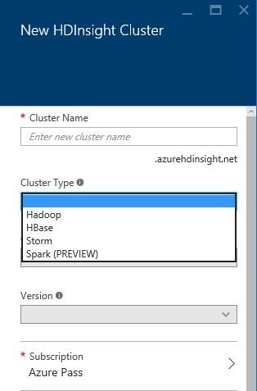
HDInsight Cluster Types
Hadoop: Query workloads
Reliable data storage, simple MapReduce
HBase: NoSQL workloads
Distributed database offering random access to large amounts of data
Apache Storm: Stream workloads
Real-time analysis of moving data streams
Apache Spark: In-Memory Parallel Processing workloads

Slide 5
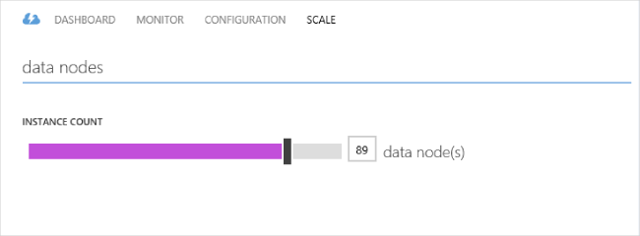
Apache Spark for Azure HDInsight
In-memory processing for really big data
Provision a Spark cluster with a few button clicks
Includes Zeppelin, Jupyter (IPython), Spark SQL, MLib, and more
Easily scale up or down as needed to meet demand
Notes:
Spark can perform up to 100 times faster than Hadoop thanks to its in-memory parallel processing model.

Slide 6
Items of Note About HDInsight
HDFS transparently mapped to Azure blob storage
Accessed through “wasb://” protocol prefix
Most HDFS commands work (except OS-specific ones like fschk)
Can deploy from the portal, but often scripted in practice
Easier creation/deletion
There is no “suspend” on HDInsight clusters
Delete the cluster when finished to avoid unnecessary charges
Data in blob storage stays behind IF you use a separate storage account (i.e., storage account in different resource group)

Slide 7
Hands-On Lab
Apache Spark for Azure HDInsight
HDInsight Spark HOL.html

